Slide 1
California Illegal Dumping Technical Advisory Committee (IDTAC)
Chair
Larry Sweetser

Slide 2
Statewide IDTAC
Assess the extent of the illegal dumping problem
Develop recommendations to CalRecycle to enhance the effectiveness of local and state responses to the problem
Provide resources and networking to local agencies and advocates
30 Members representing:
State and local agencies and associations
Private waste sector
Enforcement agencies
Environmental groups
Public representative

Slide 3
IDTAC Members
Alameda Co Supervisor - represented by Erin Armstrong/ California State Association of Counties, Nate Miley
Alameda County DA’s Office/San Joaquin County DA’s Office, Alyce Sandbach/Jennifer (Kibbe) Day
California Environmental Protection Agency, Hasti Javid
California Hazardous Materials Investigators Association, Marr Christian/ Mark Azzouni
CalRecycle, Mark de Bie
CalTrans, Trent Manning
City of Los Angeles Bureau of Street Services, Gary Harris
City of Los Angeles Sanitation and Environment, Gonzalo Barriga
City of Manteca, Avneet Mahil
City of Oakland Public Works, Frank Foster/Jamaica Moon
City of Richmond Code Enforcement, Eva Mann
City of San Jose BeautifySJ Initiative, Olympia Williams
Del Norte County Solid Waste Authority, Tedd Ward
Monterey County Illegal Dumping Task Force, Maria Ferdin
Sacramento County Waste Management Authority, Chris Lehon
California Conference of Directors of Environmental Health (CCDEH) Representative, Vacant
California Conservation Corps Region III, Sara Weaver
California Product Stewardship Council, Doug Kobold (Vice Chair)
Californians Against Waste, Nick Lapis
California Waste Haulers Council, Kathy Lynch
County Engineers Association of California, Vacant
Environmental Services Joint Powers Authority, Larry Sweetser (Chair)
Keep California Beautiful, Christine Flowers
League of California Cities, Derek Dolfie
Mattress Recycling Council, Justine Fallon/ Taylor Grimes
National Stewardship Action Council, Heidi Sanborn
Public Member Representative, Traci Glaves
Resource Recovery Coalition of California, Veronica Pardo
San Diego River Park Foundation, Rob Hutsel
Waste Management Industry, Vacant
Other interested parties
Sharon Anderson, Coordinator, CalRecycle

Slide 4
Workplan 2020
Get Involved in solutions for California
Next full IDTAC meeting – May 26, 2021
Ideas for discussion welcome!
Outline priorities
Created subcommittees
Enforcement
Outreach
Strategy
Standards

Slide 5
Past Efforts
Website https://www.calrecycle.ca.gov/IllegalDump/
Illegal Dumping Toolbox
Prevention, Abatement, Cleanup and Enforcement (PACE)
Outreach
Presentations
Local Jurisdiction Survey
Rules of evidence guidance
Refuse hauler service provider guidance
Homeless encampment guide

Slide 6
Current Efforts
Review state website and online resources
Messaging campaign
GeoMap
Locate local illegal dumping resource contact
Guidance for creating partnerships
Compile enforcement tools
Develop illegal dumping collection survey
Training requirements guidance different clean up activities
ListServ

Slide 8
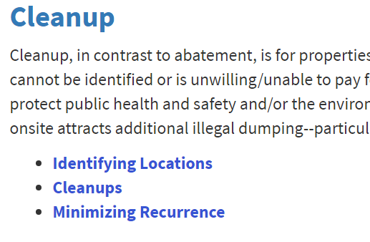
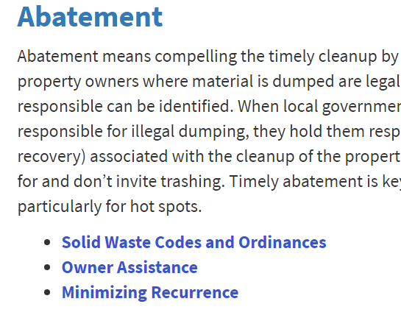
Keys to Eradication

